Slide 1
Calculo Numérico I Clase Errores de Truncamiento
Dr. Luis Sanchez

Slide 2
Objectives
Recognizing that truncation errors occur when exact mathematical formulations are represented by approximations.
Knowing how to use the Taylor series to estimate truncation errors.
Recognizing that efforts to minimize truncation errors can sometimes increase roundoff errors.

Slide 3
Truncation Errors
Occur when exact mathematical formulations are represented by approximations.
Example 1:
Taylor series
Example 2: approximation to a derivative using a finite-difference equation:

Slide 4
Taylor series widely used to express functions in an approximate fashion
Taylor’s Theorem:
Any smooth function can be approximated as a polynomial
Taylor series expansions
where h = x_{i+1} - x_{i}
0th
1st
2nd
3rd
4th

Slide 5
Each term adds more information:
e.g., f(x) = - 0.1x⁴ - 0.15x³ - 0.5x² - 0.25x + 1.2 at x = 1
= 1.2
≈ 1.2 – 0.25(1) = 0.95
≈ 1.2 – 0.25(1) –(1.0/(1*2))*1² = 0.45
= 1.2 – 0.25(1) – (1.0/(1*2))*1²
– (0.9/(1*2*3))*1³ = 0.3

Slide 6
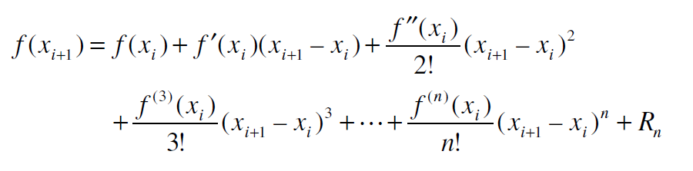
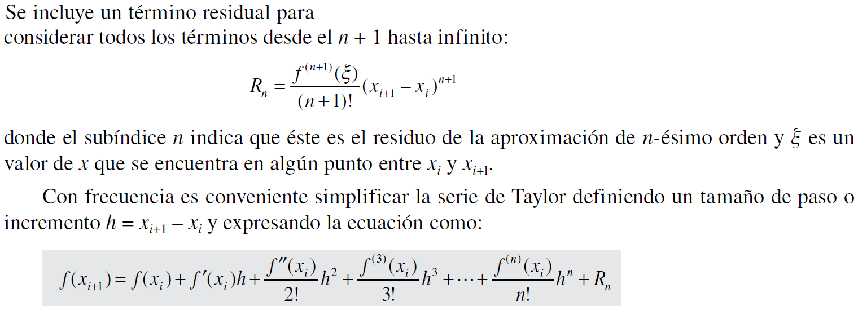
The Taylor Series: Remainder Term

Slide 7
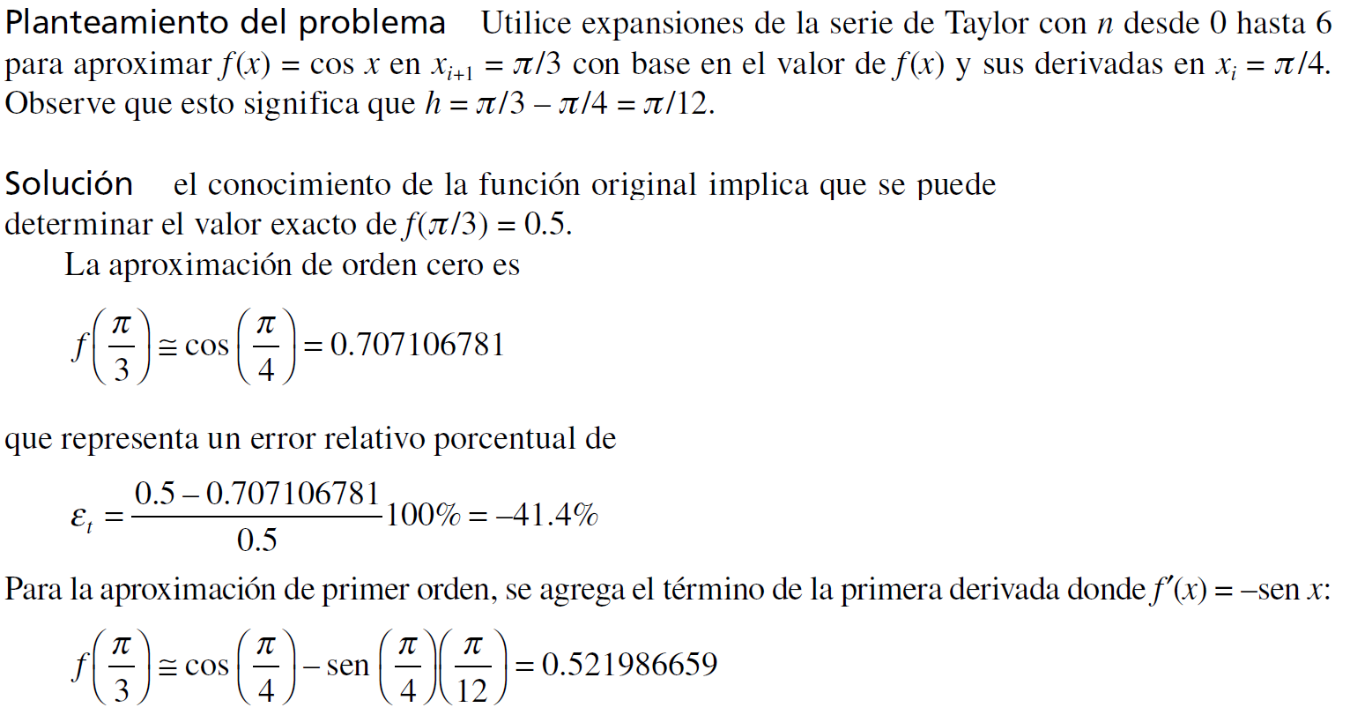

EJEMPLO: Uso de la expansión de la serie de Taylor para aproximar una función con un número infinito de derivadas

Slide 8
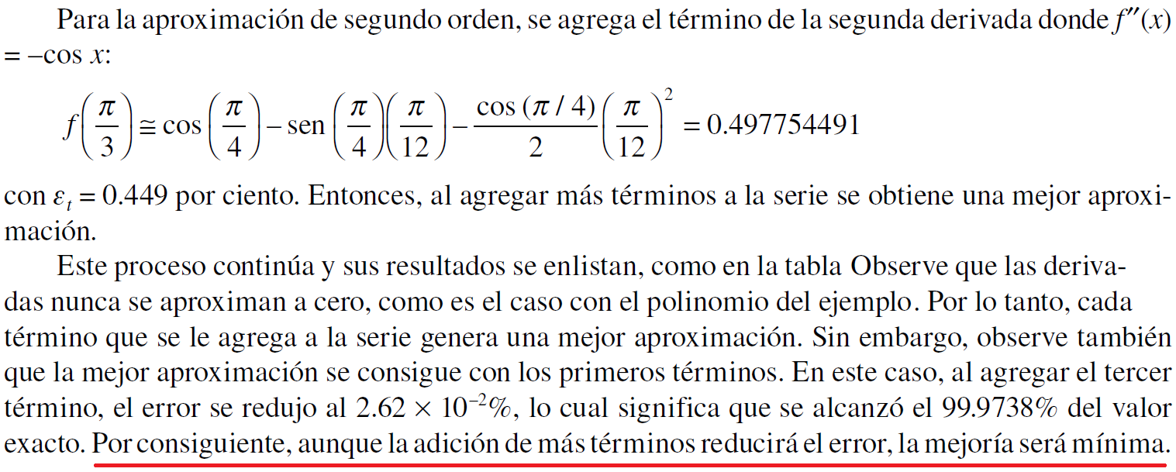
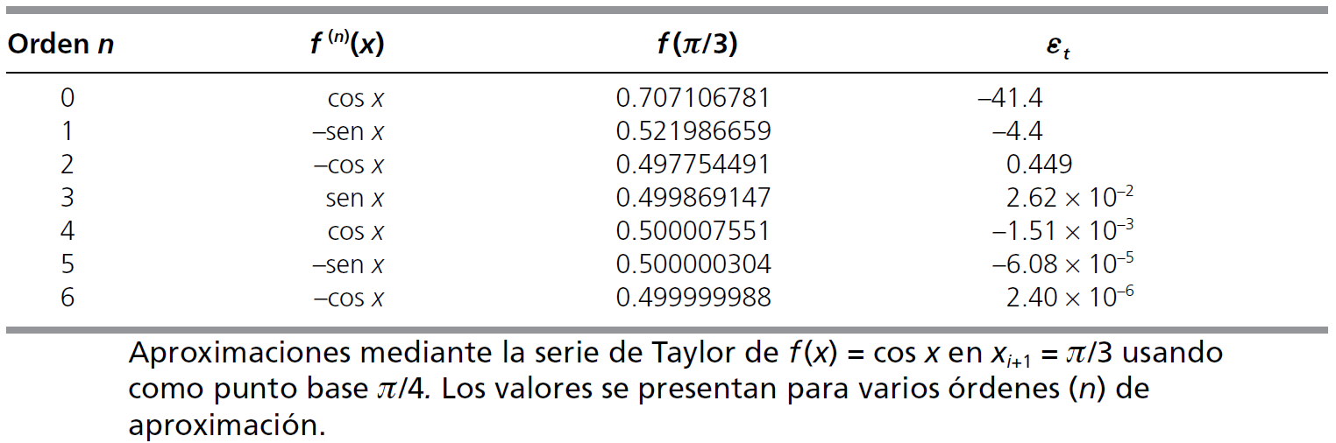

Slide 9
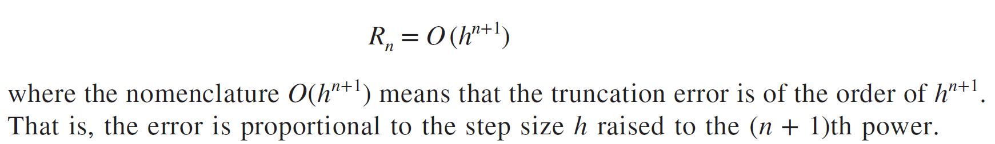
Truncation Error
In general, the nth order Taylor series expansion will be exact for an nth order polynomial.
In other cases, the remainder term R_{n} is of the order of h^{n+1}, meaning:
The more terms are used, the smaller the error, and
The smaller the spacing, the smaller the error for a given number of terms.

Slide 10
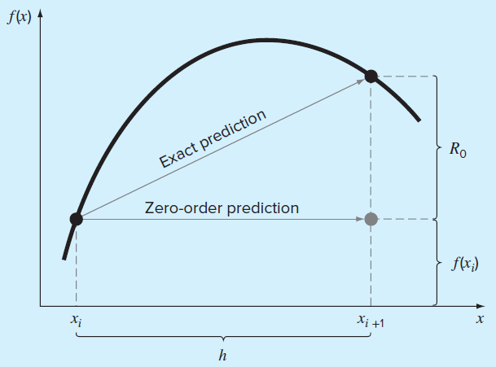
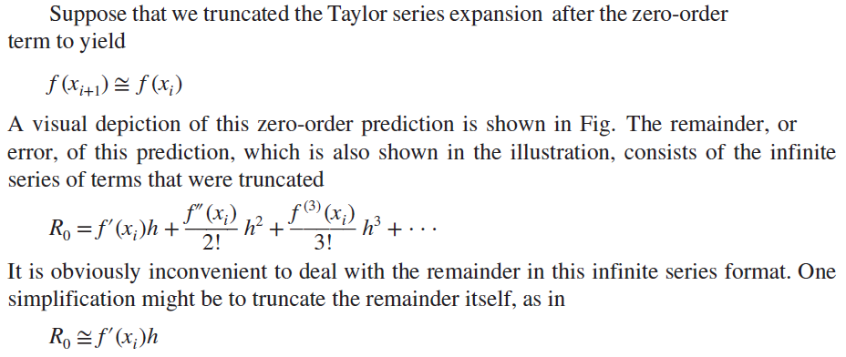
The Remainder for the Taylor Series Expansion

Slide 11
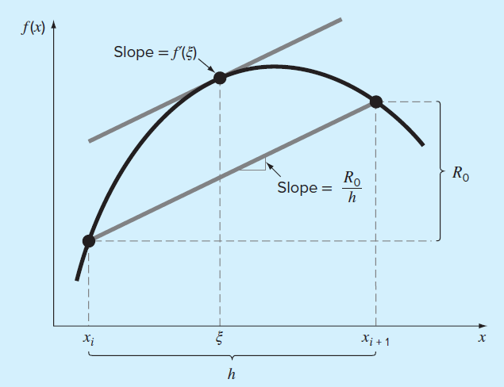
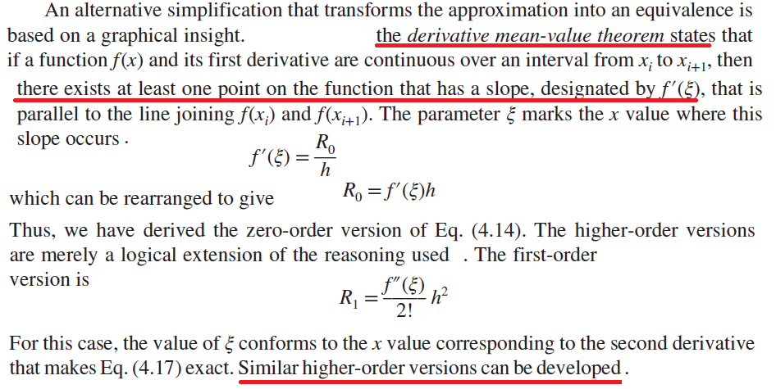

Slide 12
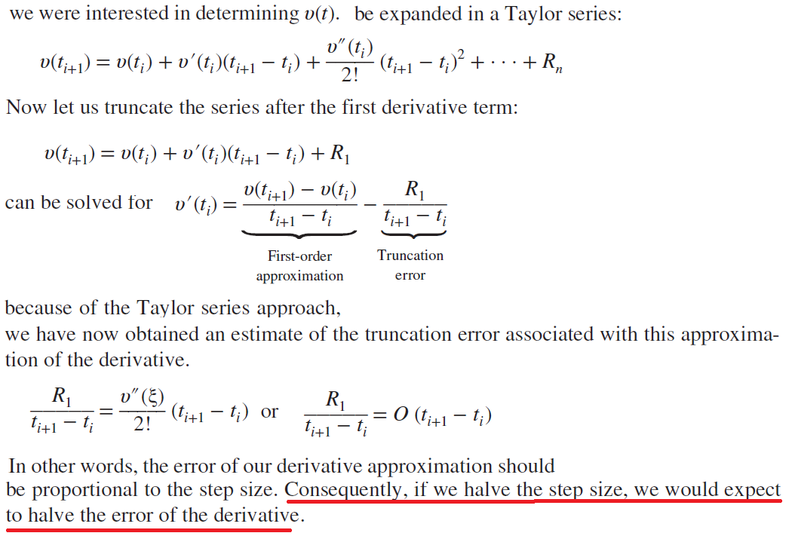
Using the Taylor Series to Estimate Truncation Errors

Slide 13
Total Numerical Error
Sum of
round-off error and
truncation error
As step size ↓, #computations ⁭
round-off error ⁭ (e.g. due to subtractive cancellation or large numbers of computations)
truncation error ↓
Point of diminishing returns is when round-off error begins to negate benefits of step-size reduction
Trade-off here

Slide 14
Other Errors
Blunders - errors caused by malfunctions of the computer or human imperfection
In early years of computers, erroneous numerical results could sometimes be attributed to malfunctions of the computer itself
Today, most blunders must be attributed to human imperfection
Can be avoided only by sound knowledge of fundamental principles and by the care when approaching and designing our solutions to the problem
Model errors - errors resulting from incomplete mathematical models
When some latent effects are not taken into account or ignored

Slide 15
Other Errors
Data uncertainty - errors resulting from the accuracy and/or precision of the data
When with biased (underestimation/overestimation) or imprecise instruments
We can use descriptive statistics (viz. mean and variance) to provide a measure of the bias and imprecision
For most of this course, we will assume that we have not made gross errors (blunders), we have a sound model, and we are dealing with error-free measurements

